Slide 1
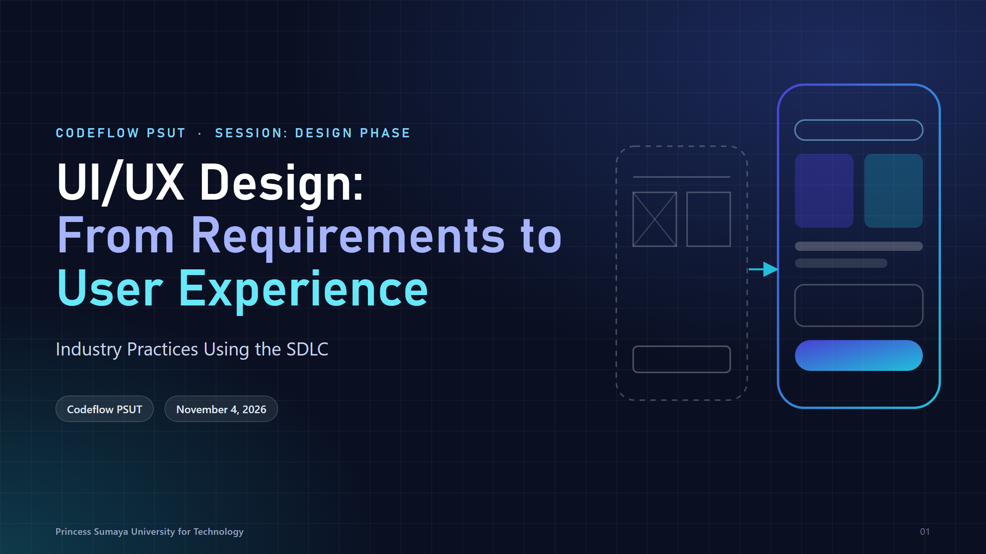
Notes:
Welcome. Today continues the SDLC design phase: last session we wrote requirements; today we turn them into interfaces people can actually use.

Slide 2
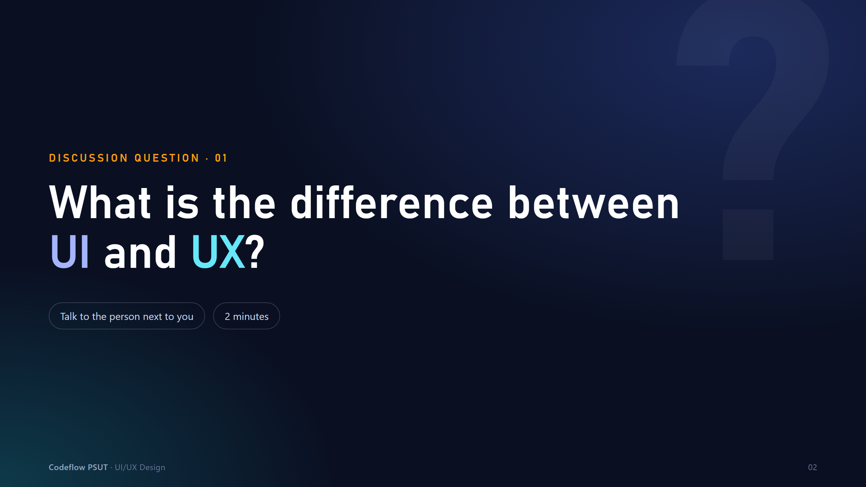
Notes:
Ask the room before advancing. Collect 4-6 answers on the board. Don't correct yet - the next three slides will.

Slide 3
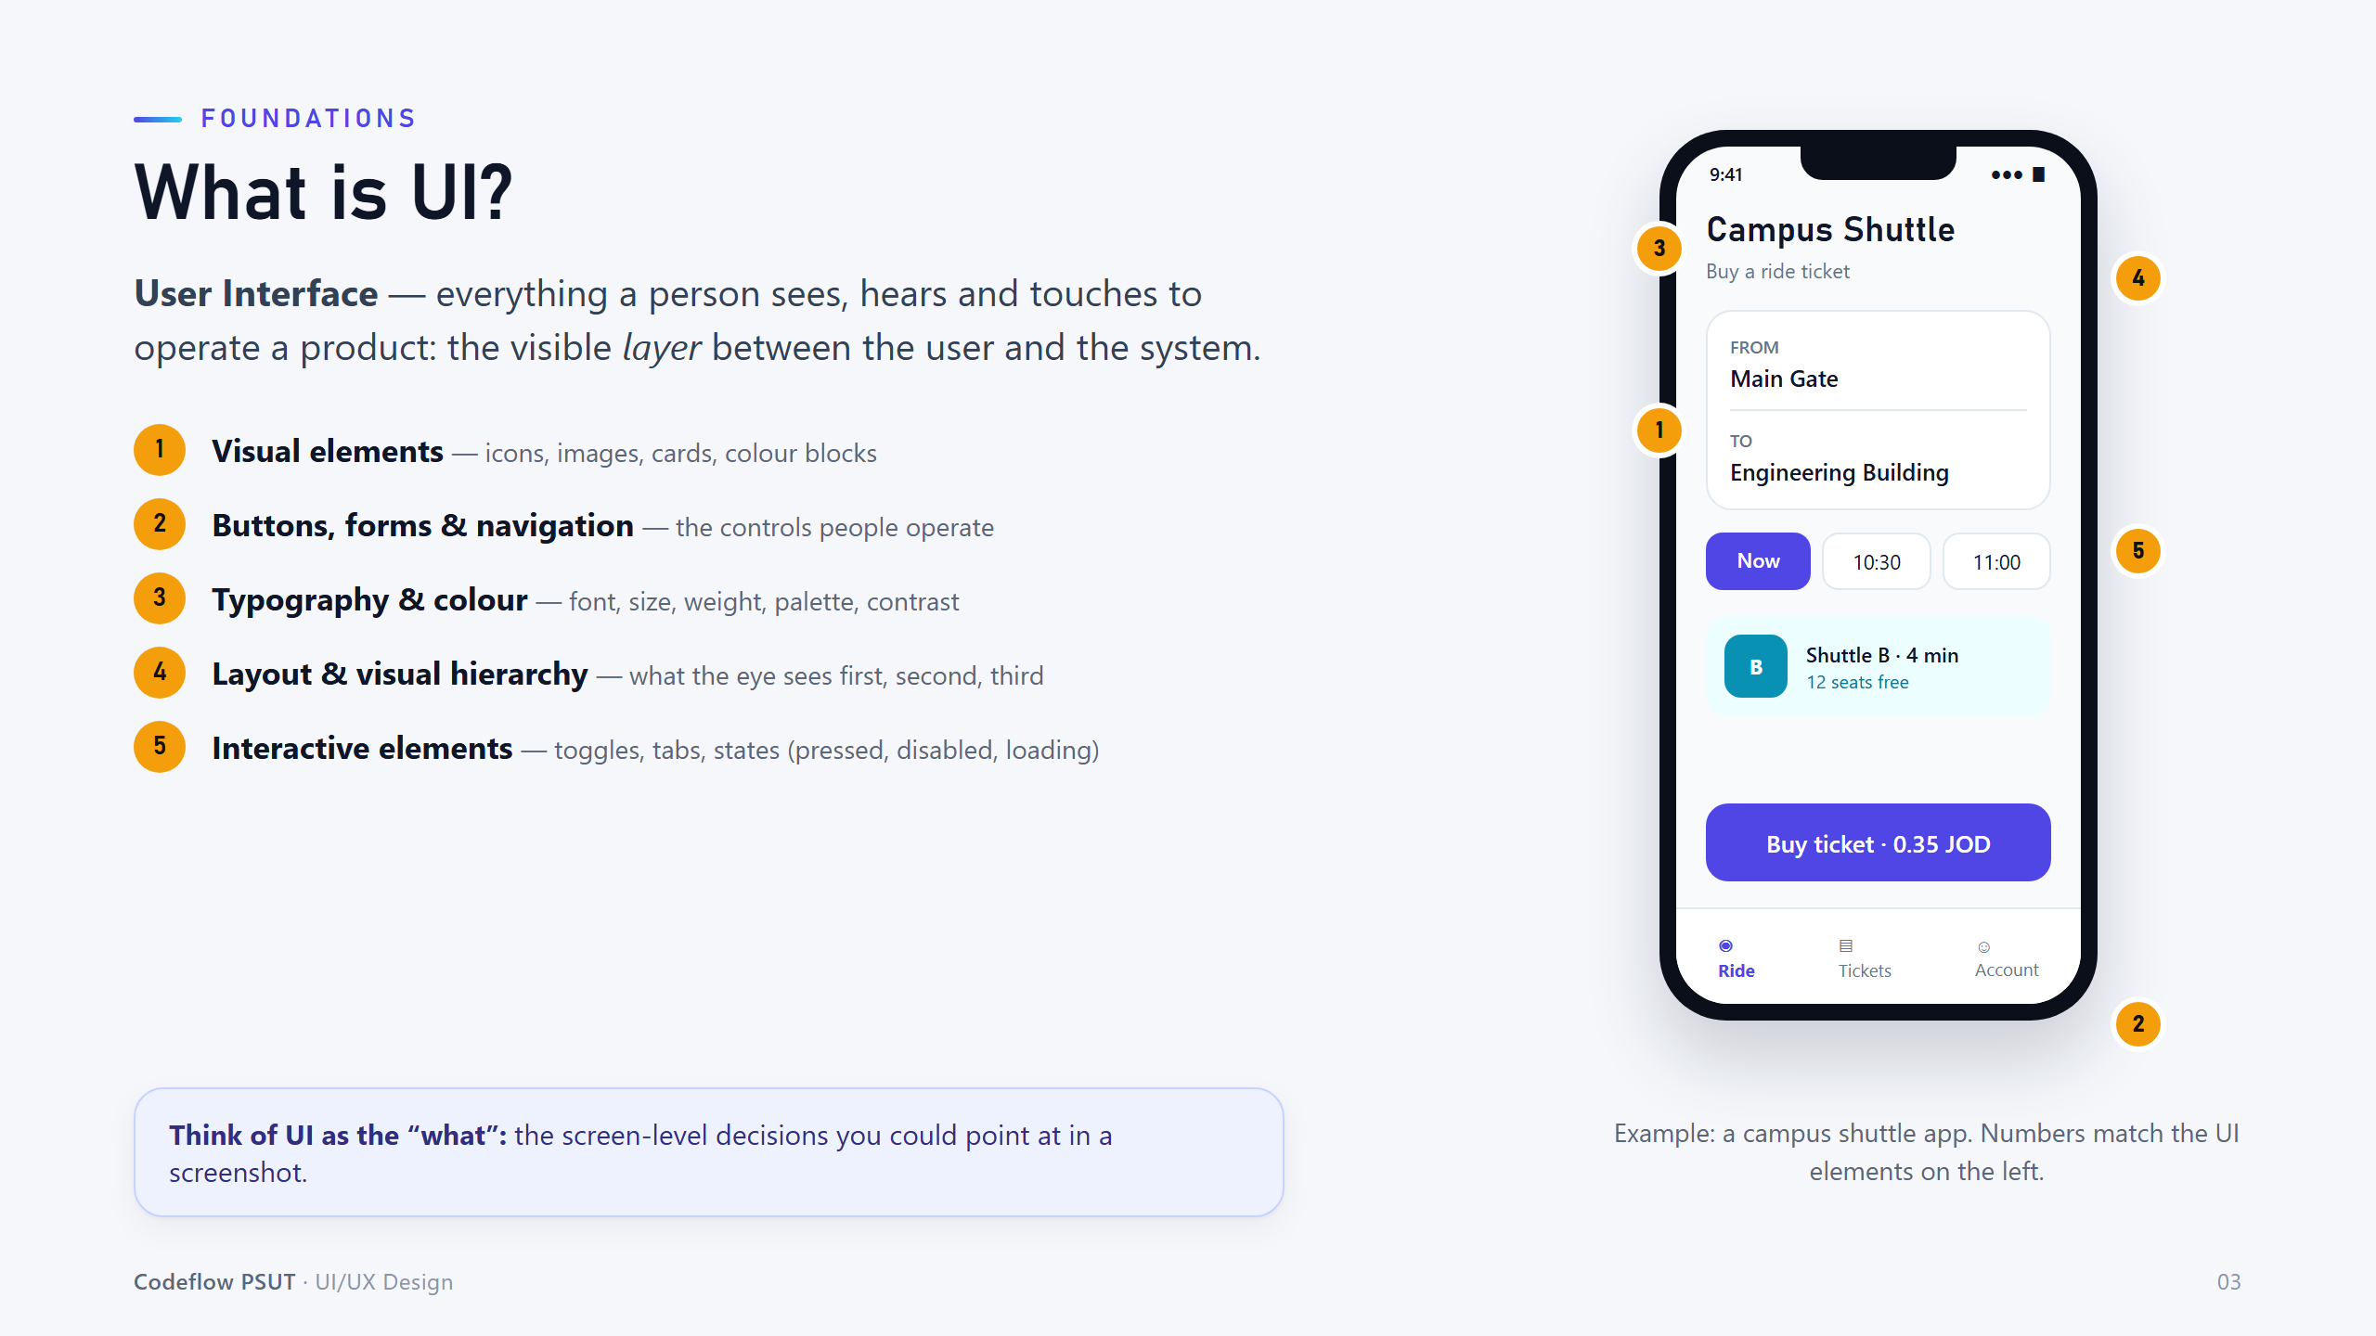
Notes:
UI is the 'what': everything you could point at in a screenshot. Walk through the numbered callouts on the shuttle app.

Slide 4
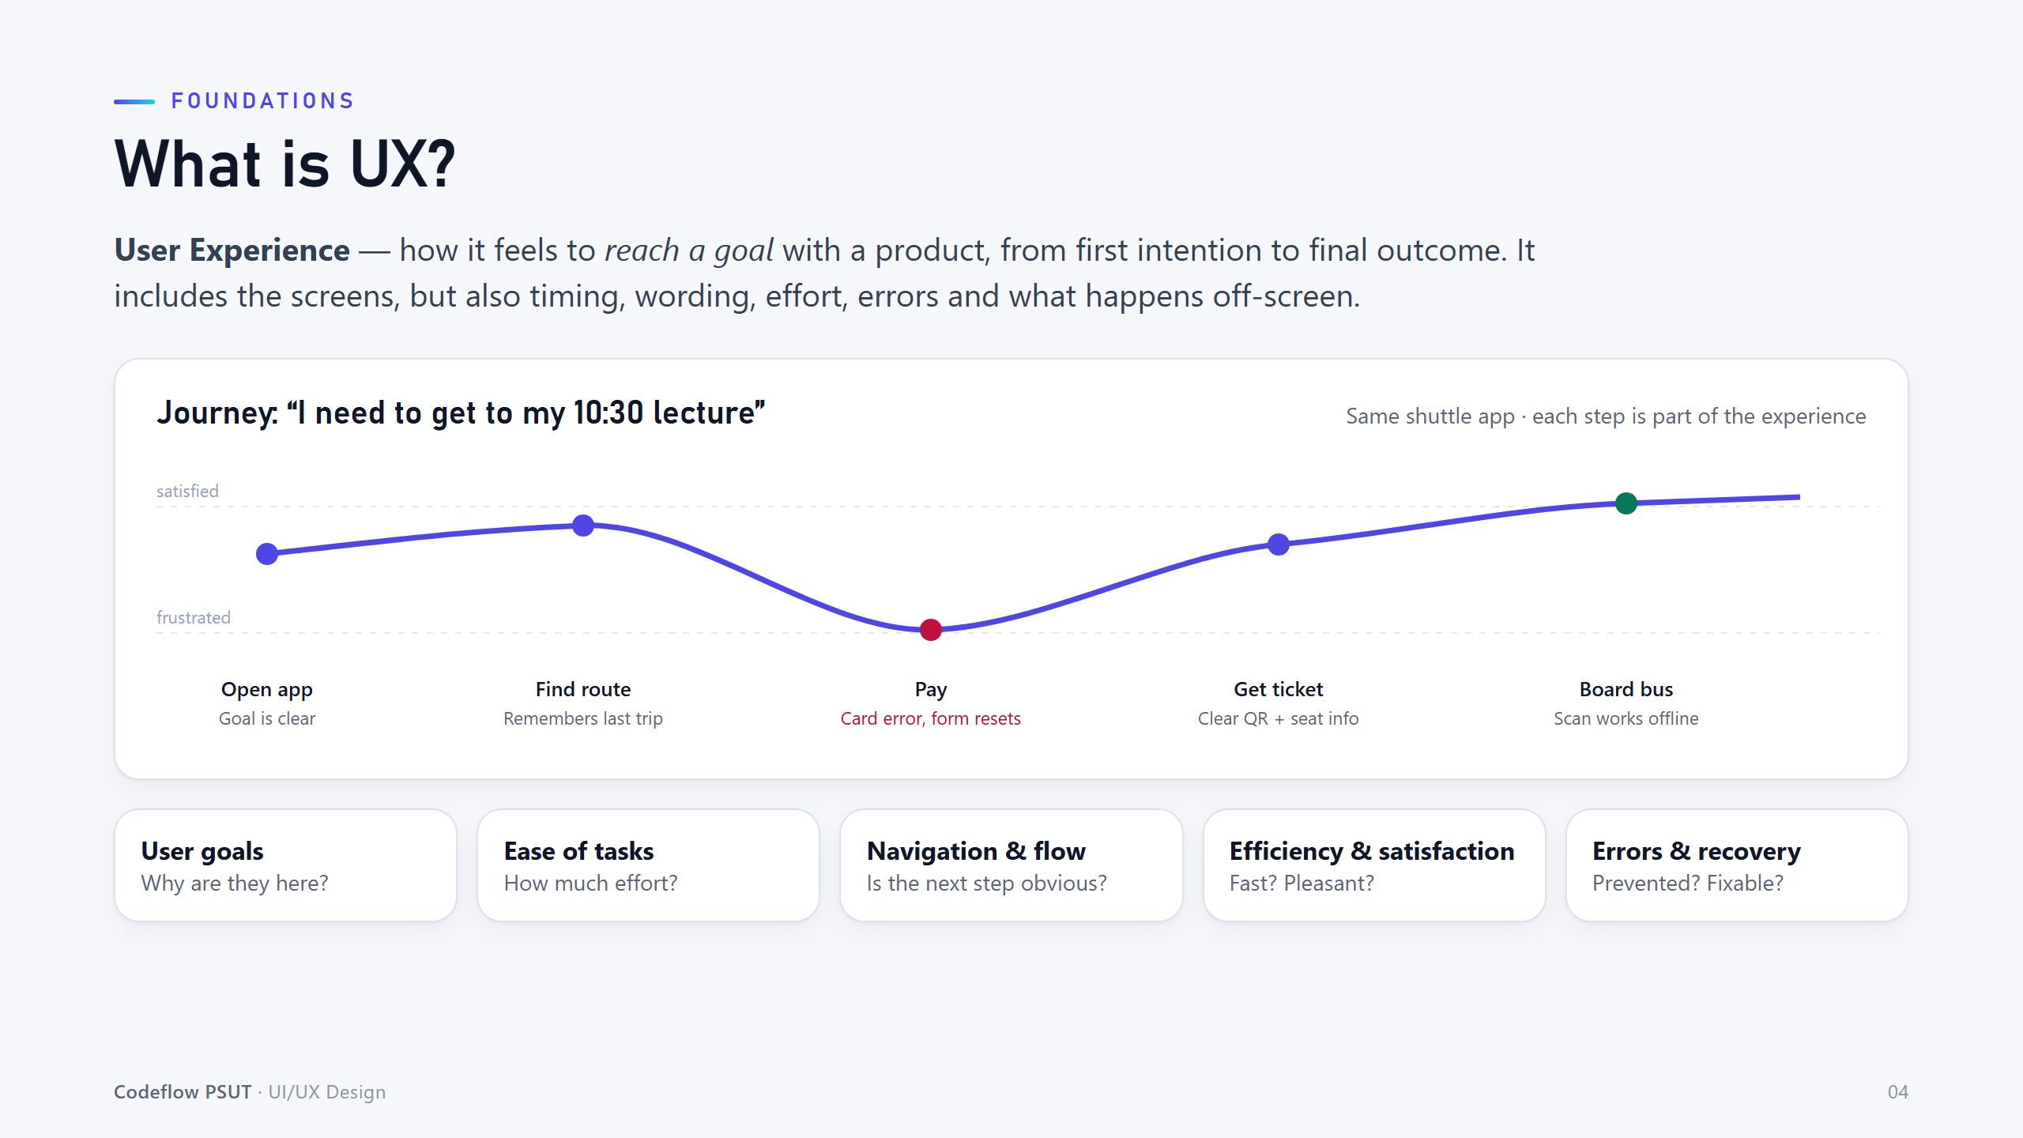
Notes:
UX is the whole journey toward a goal. Point at the dip at 'Pay': one bad moment can ruin an otherwise good product.

Slide 5
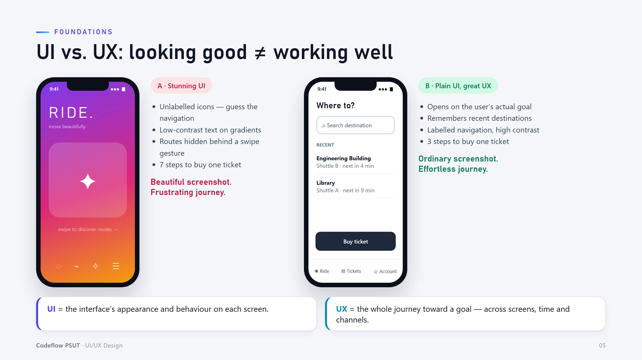
Notes:
Same task, two apps. A wins a screenshot contest; B wins with real users. Ask: which would you rather use when late for a lecture?

Slide 6
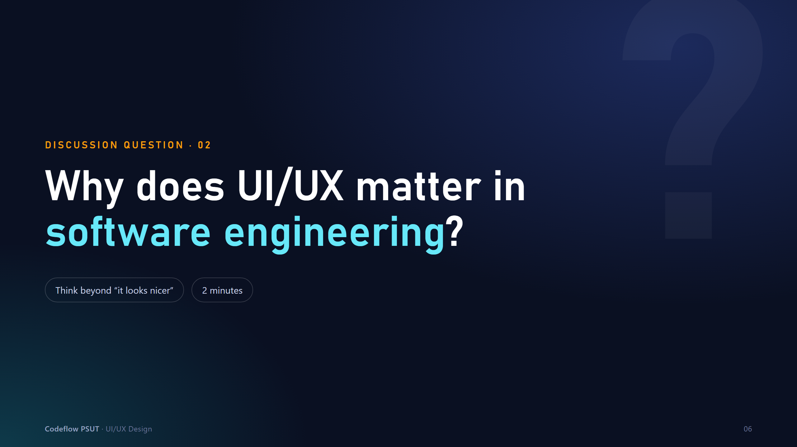
Notes:
Ask the room before advancing. Push students beyond 'it looks nicer' - think cost, errors, accessibility, adoption.

Slide 7
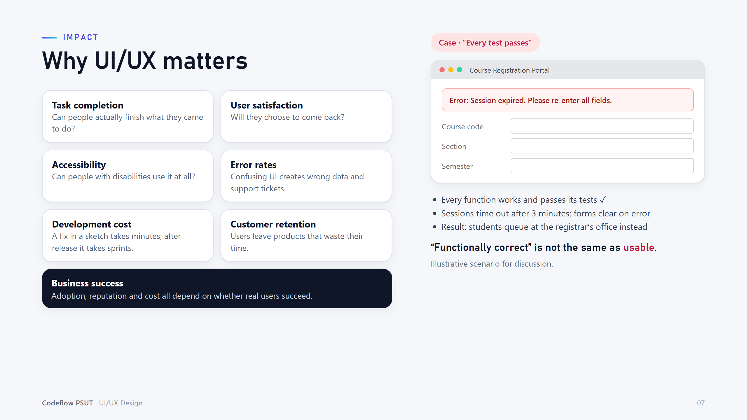
Notes:
The registration portal is functionally correct but unusable. Passing tests is not the same as meeting user needs.

Slide 8
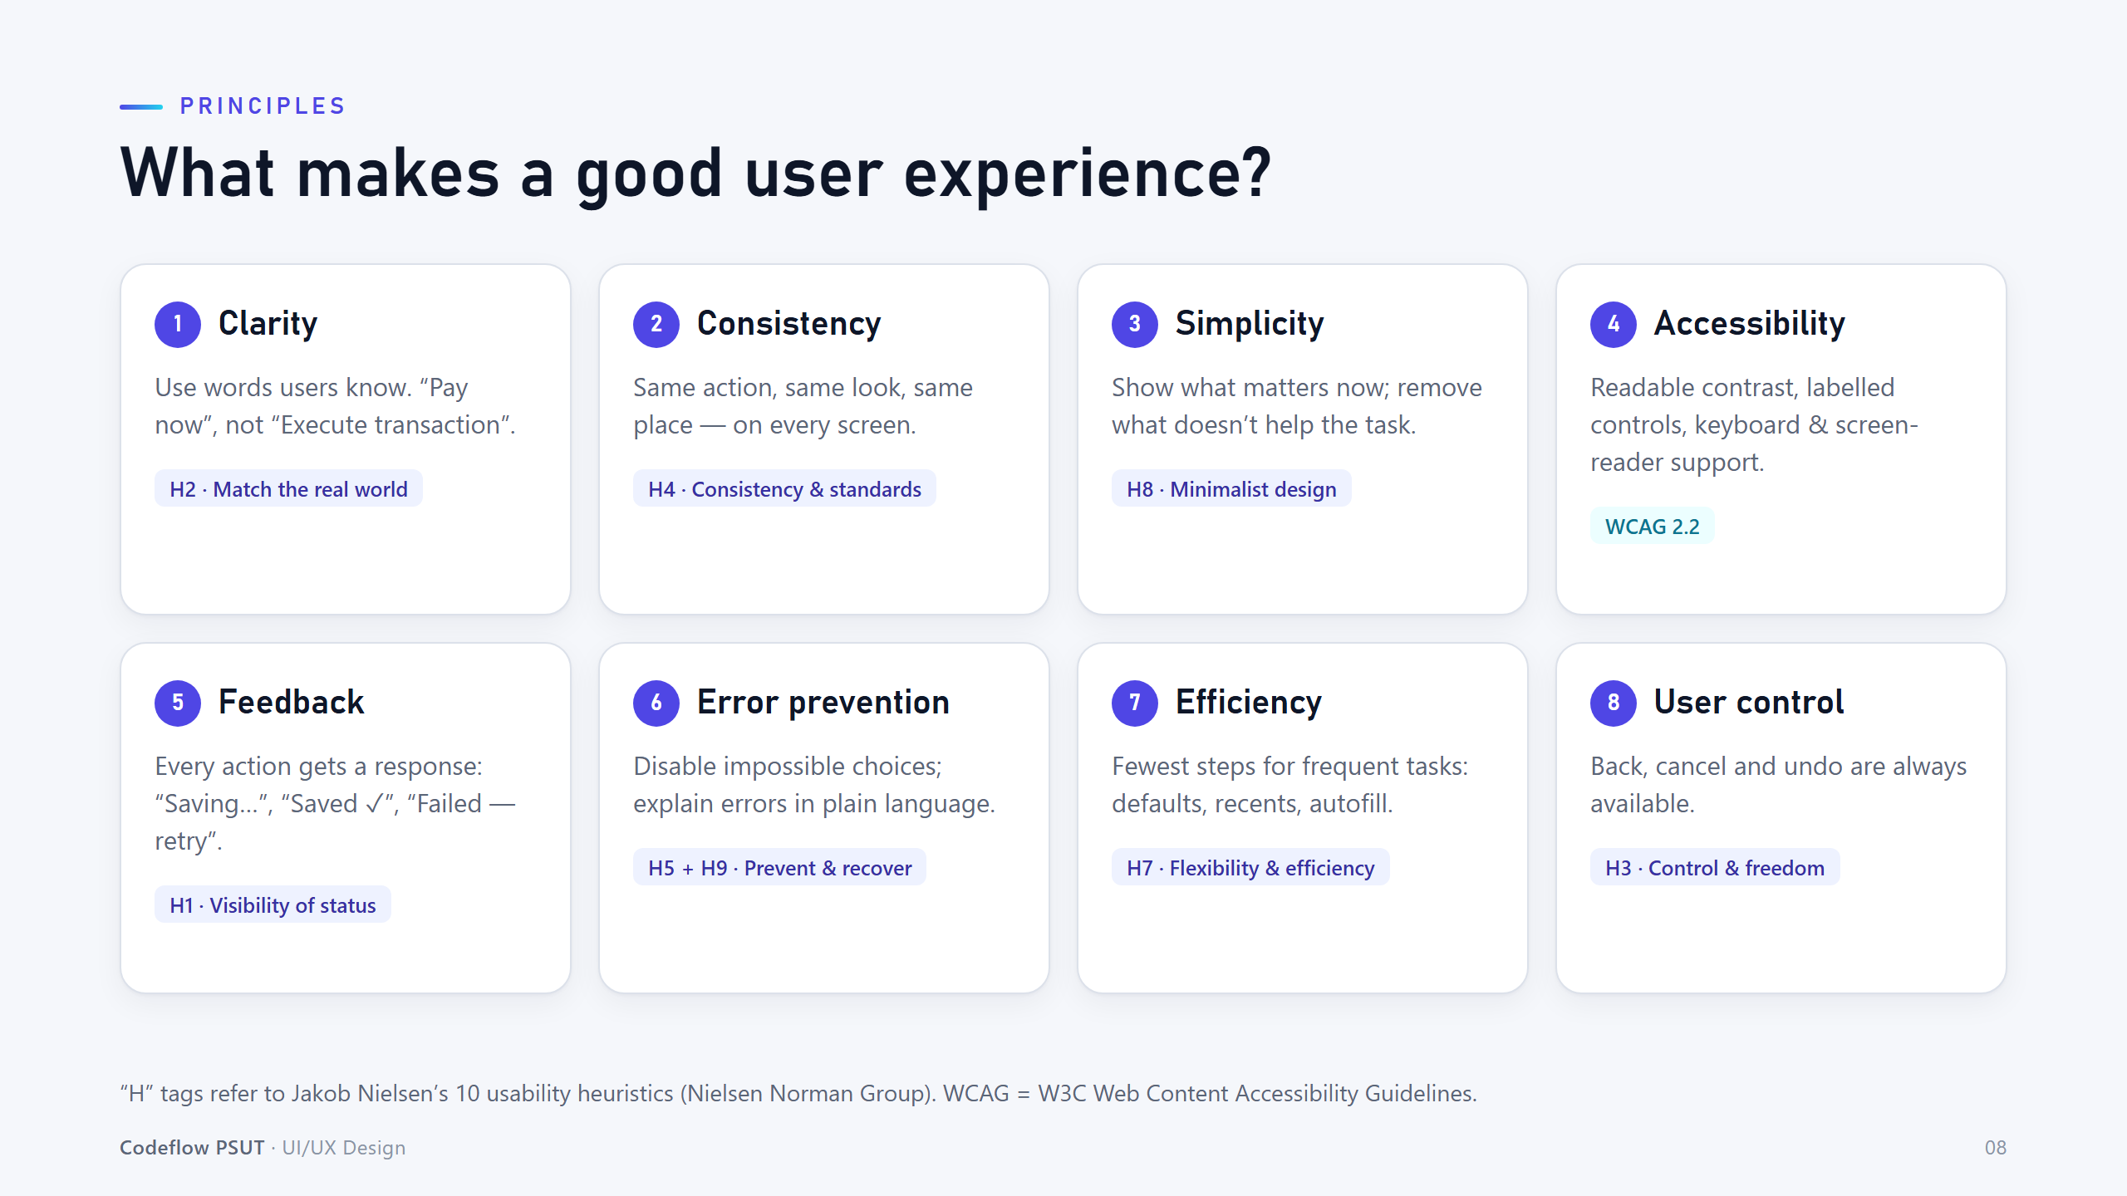
Notes:
Eight principles, each linked to a Nielsen heuristic or WCAG. Ask students for one example of each from apps they use.

Slide 9
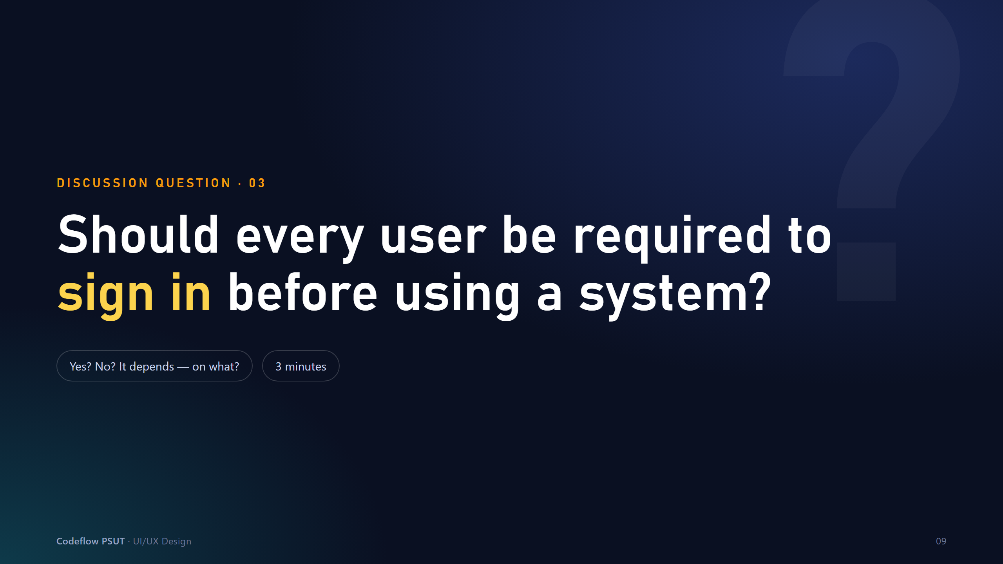
Notes:
Ask the room before advancing. Let them argue both sides; the answer is 'it depends on what the user is trying to do'.

Slide 10
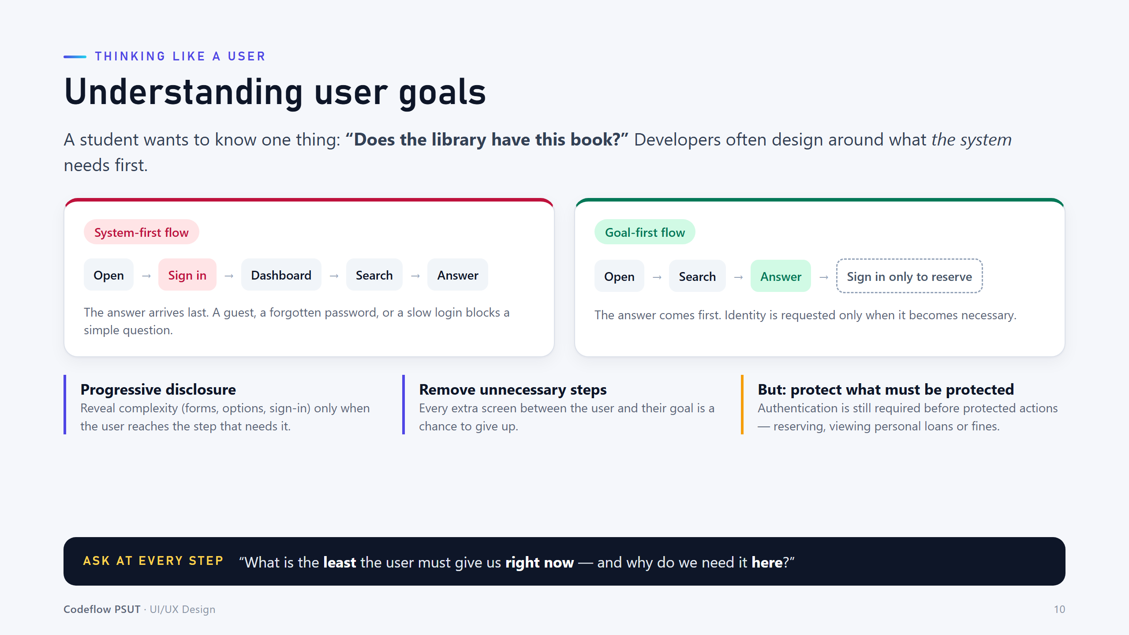
Notes:
Contrast system-first vs goal-first flows. Stress the last column: authentication is still required for protected actions.

Slide 11
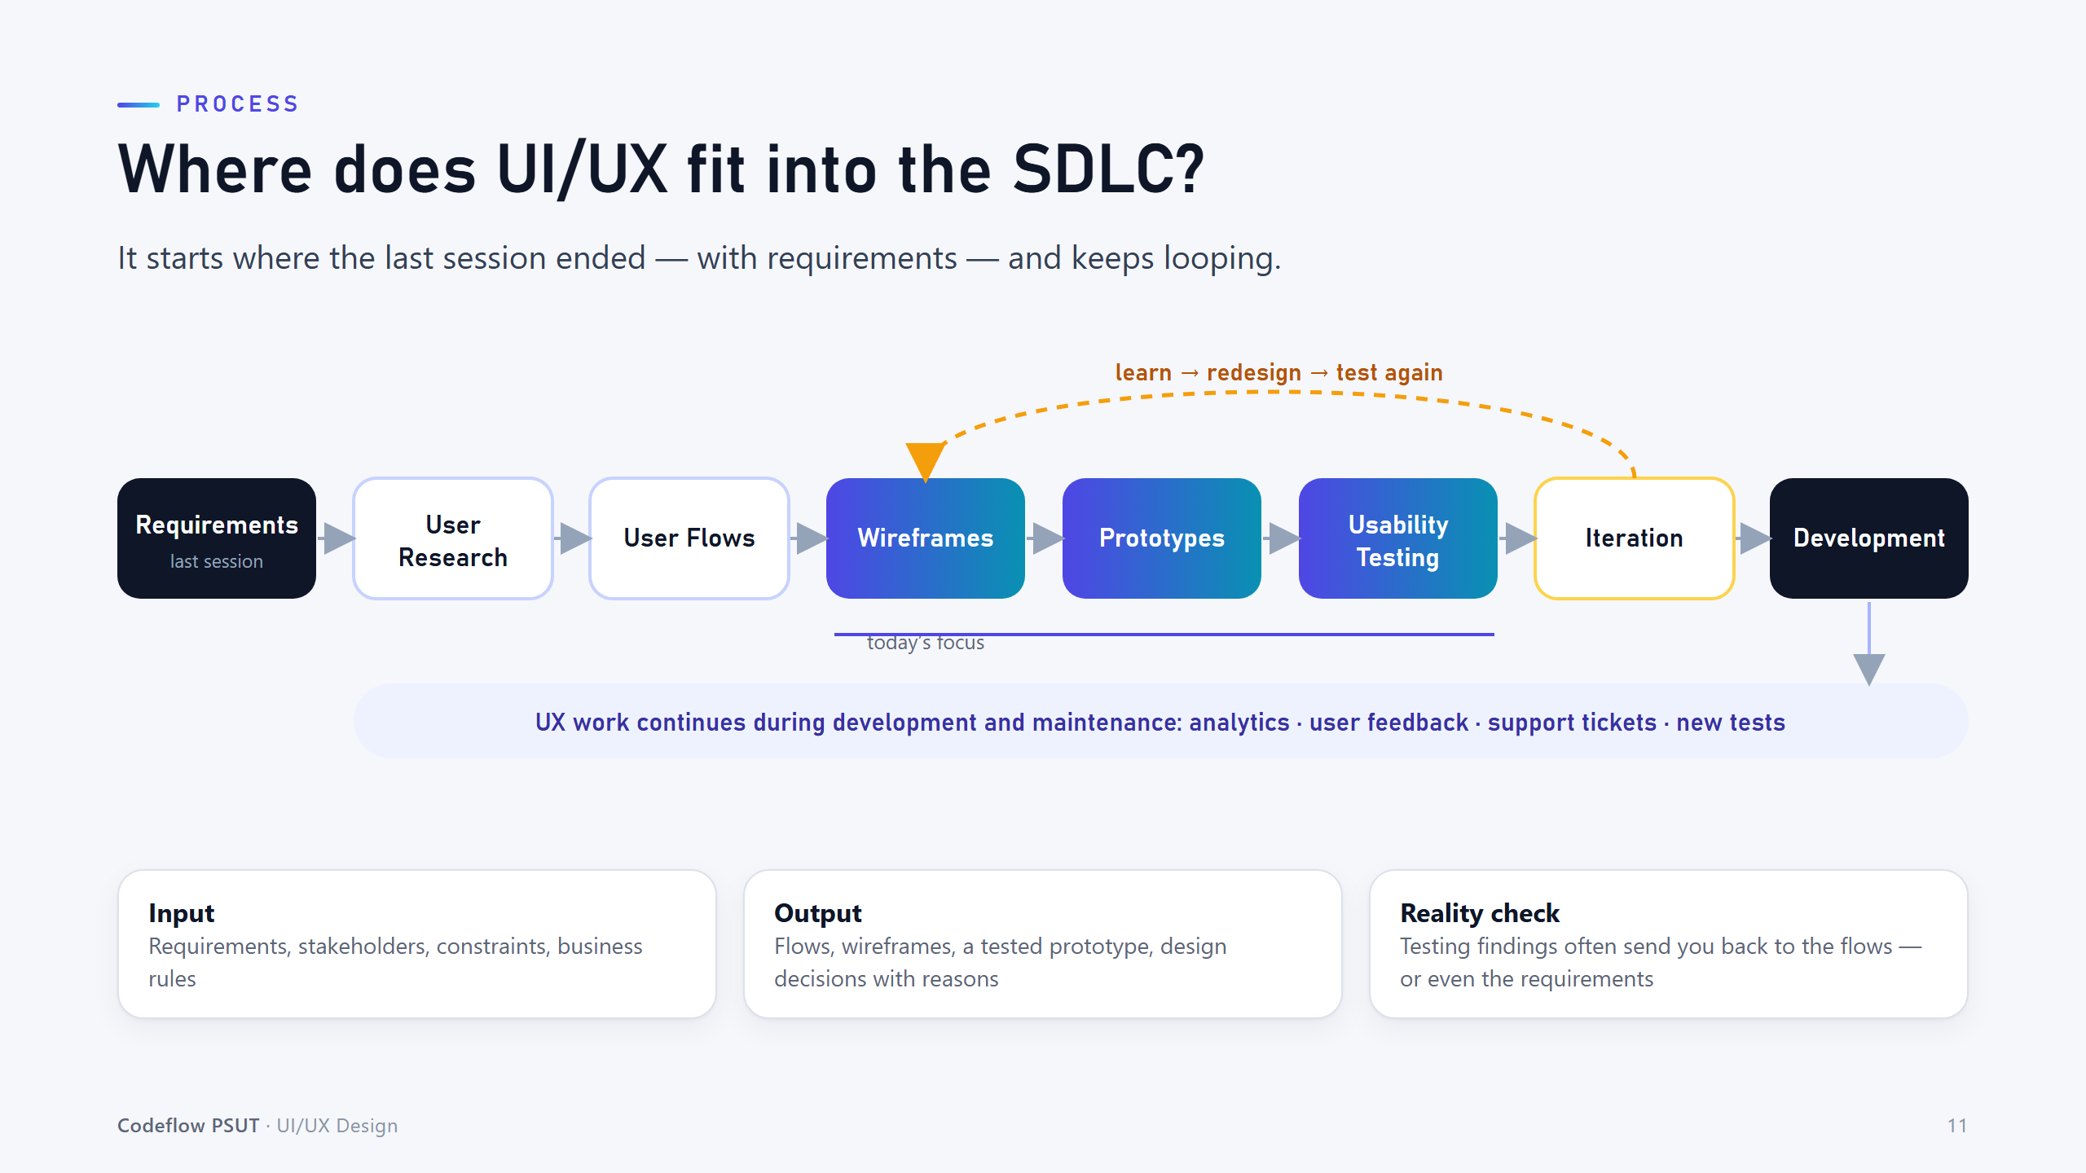
Notes:
UX is not a one-time phase. Testing often sends teams back to flows or even requirements.

Slide 12
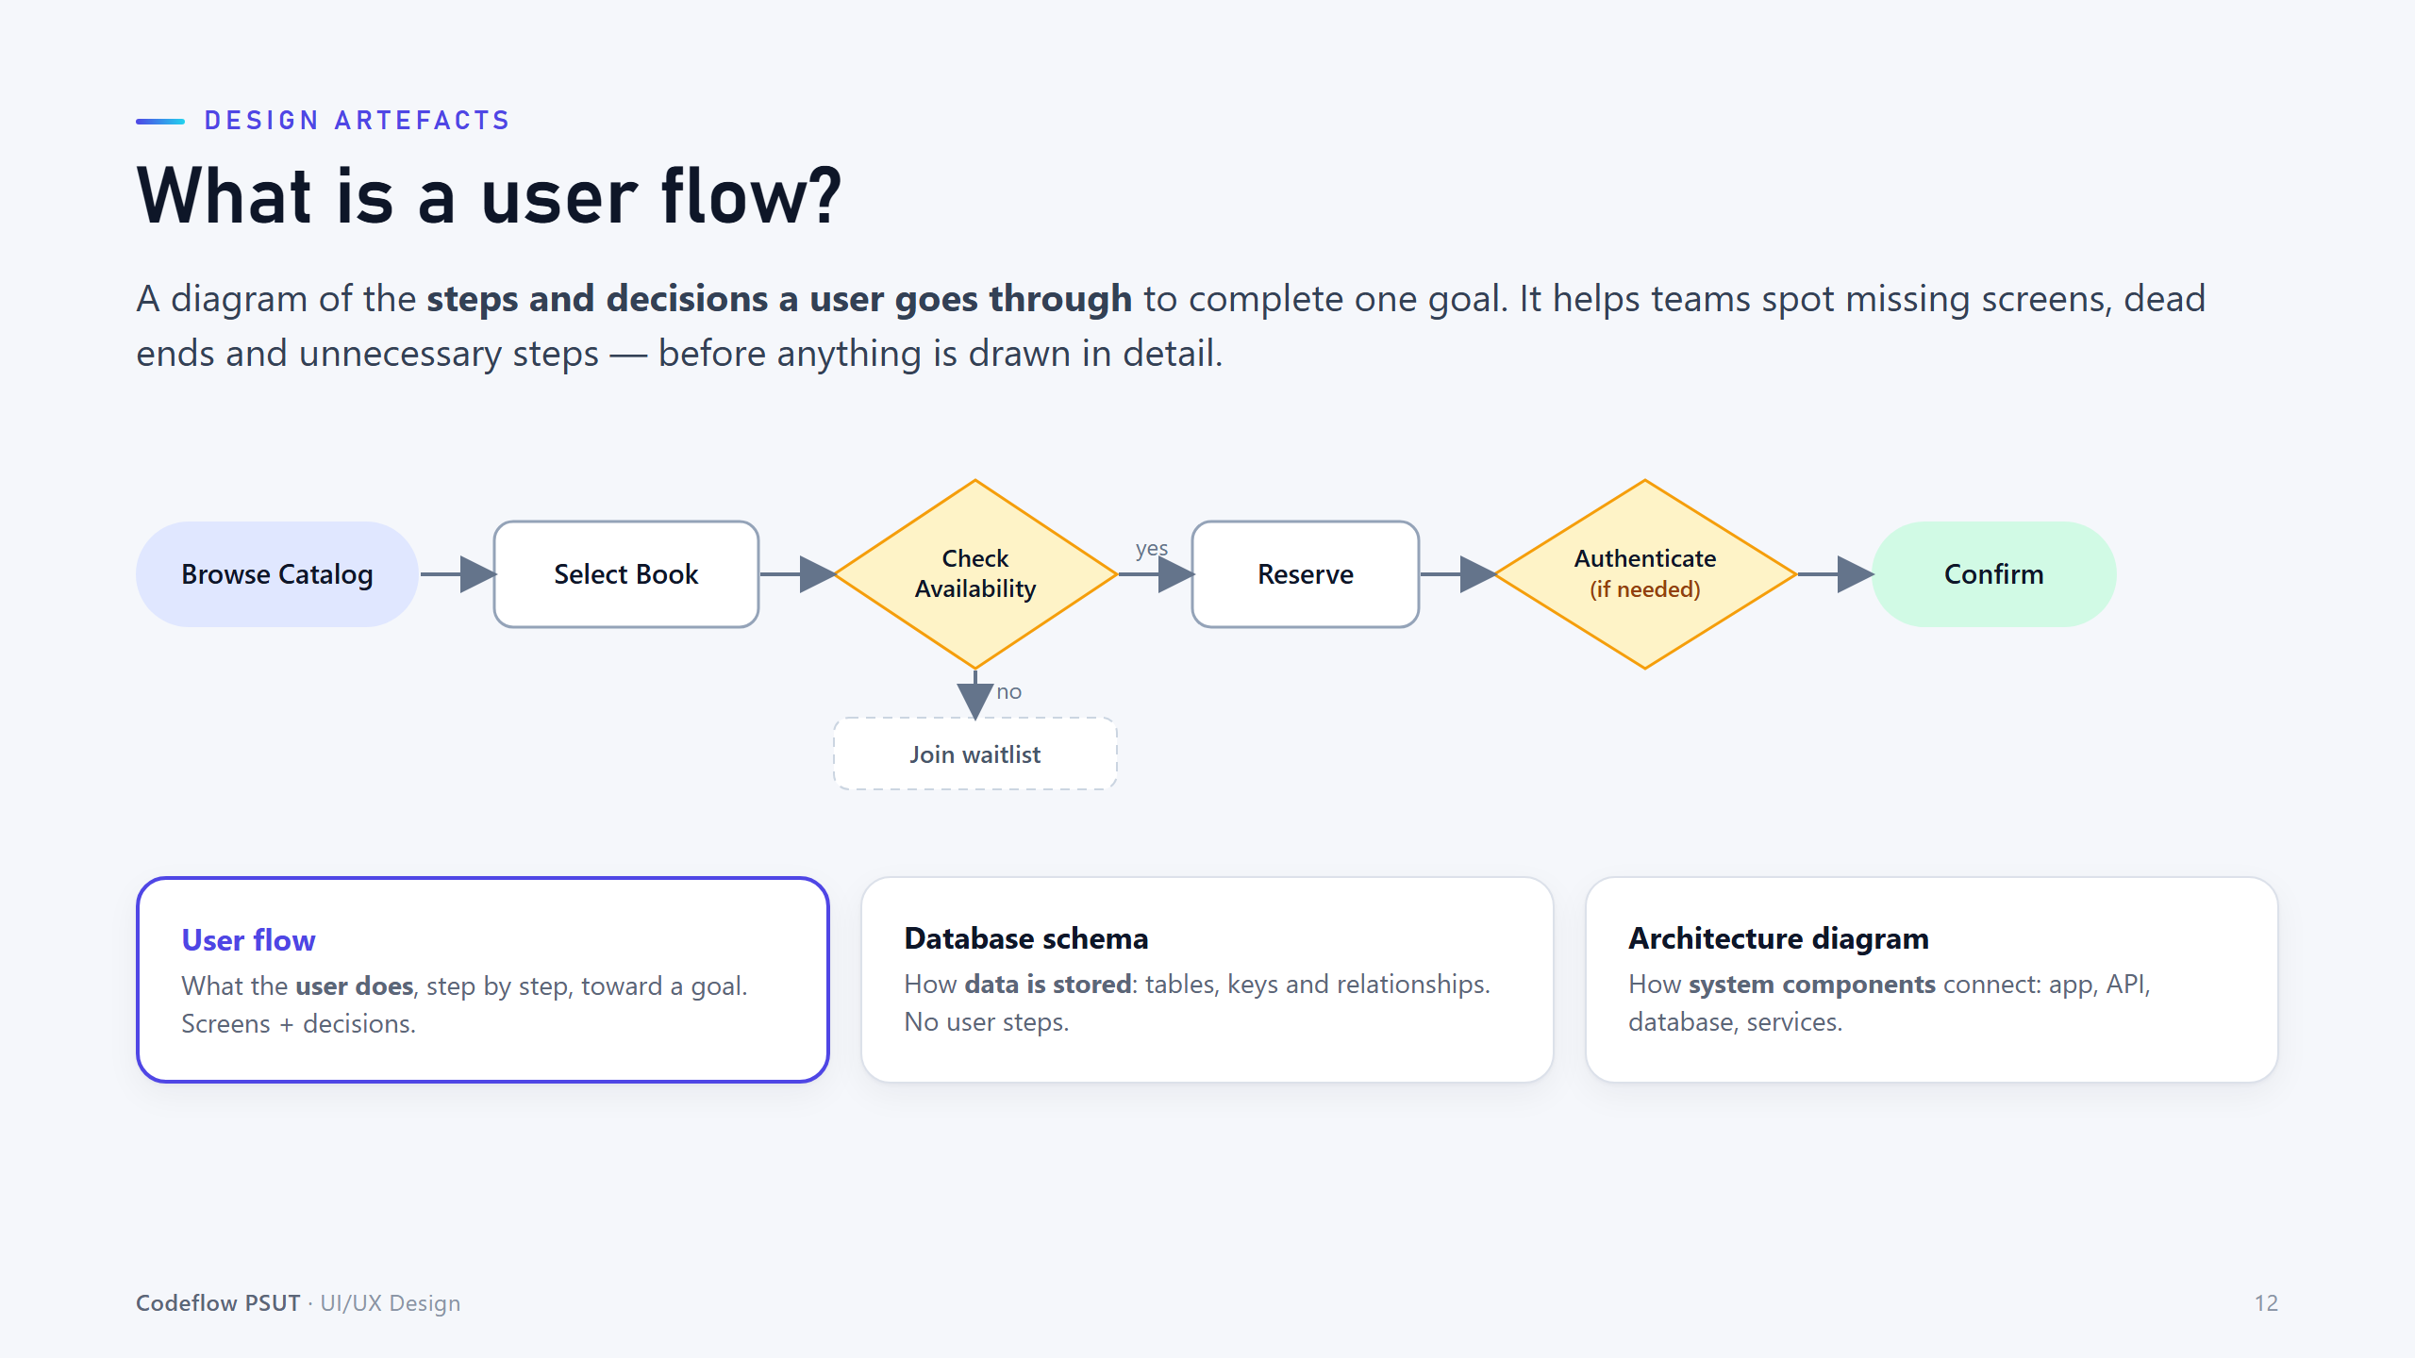
Notes:
A user flow is about what the user does - not tables (schema) or servers (architecture). Trace the 'no' branch to the waitlist.

Slide 13
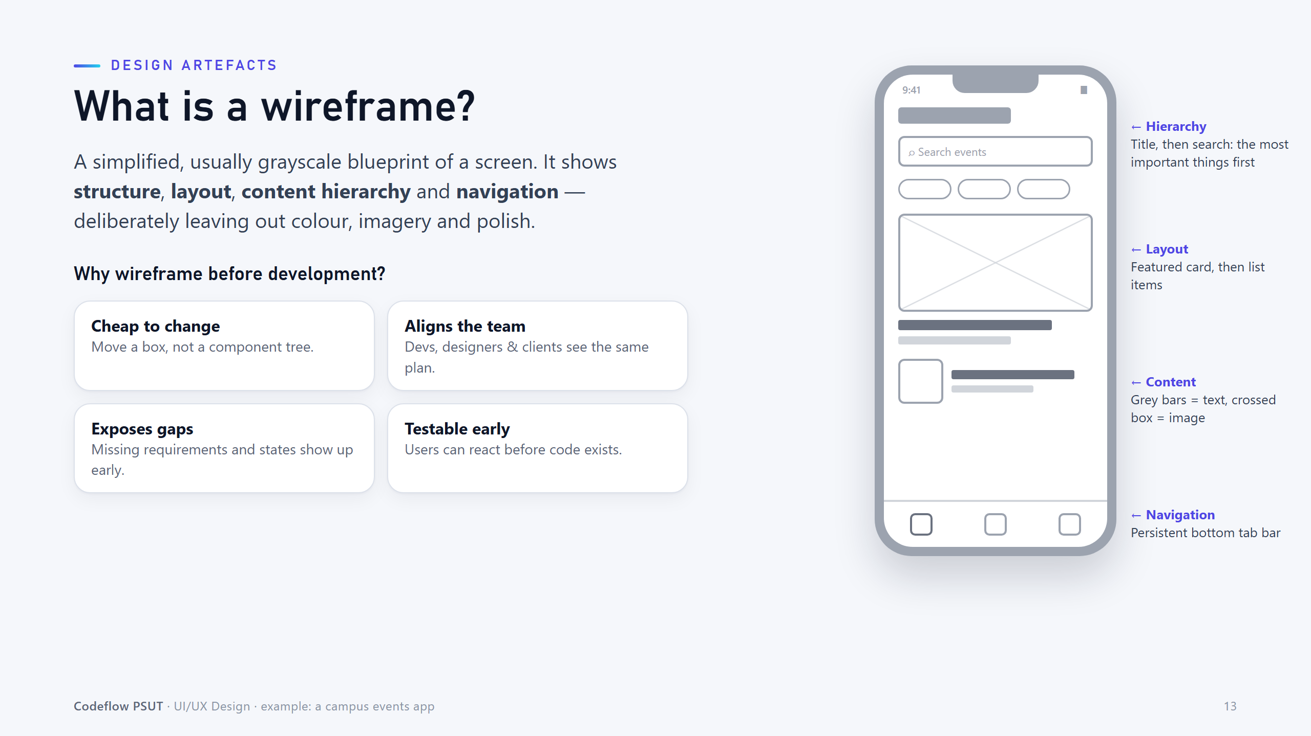
Notes:
Wireframes show structure, hierarchy, layout and navigation - deliberately without colour or polish.

Slide 14
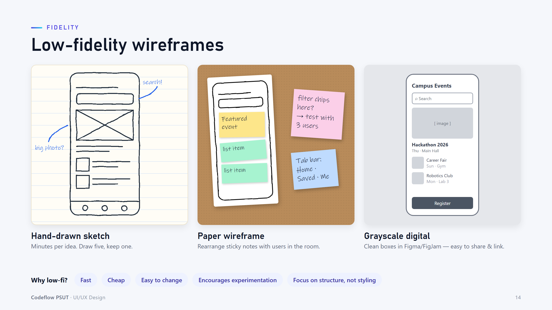
Notes:
Low-fidelity = fast and cheap. Encourage students to sketch many ideas before committing to one.

Slide 15
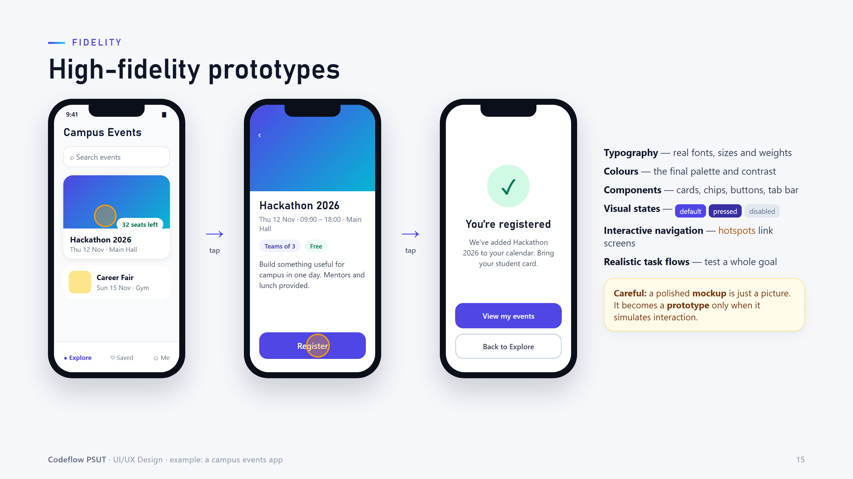
Notes:
High-fidelity adds real type, colour, components and states. A mockup only becomes a prototype when it simulates interaction.

Slide 16
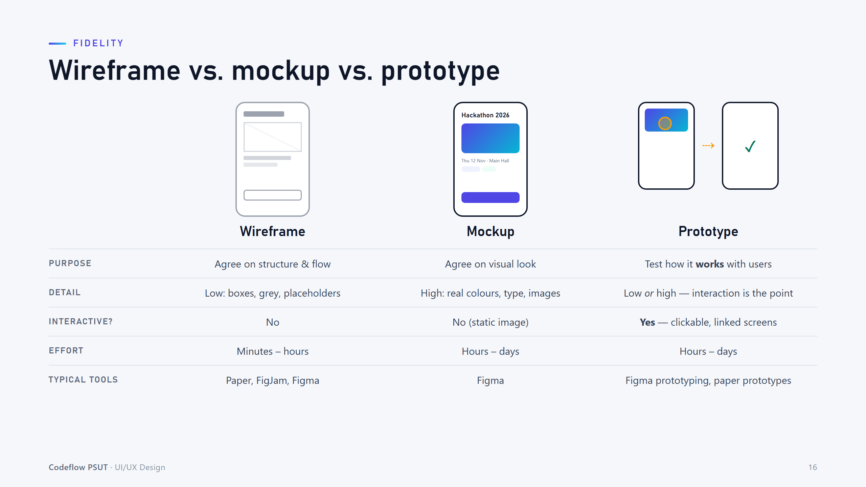
Notes:
Compare purpose, detail and interactivity. Quick check: is a beautiful Figma frame with no links a prototype? (No.)

Slide 17
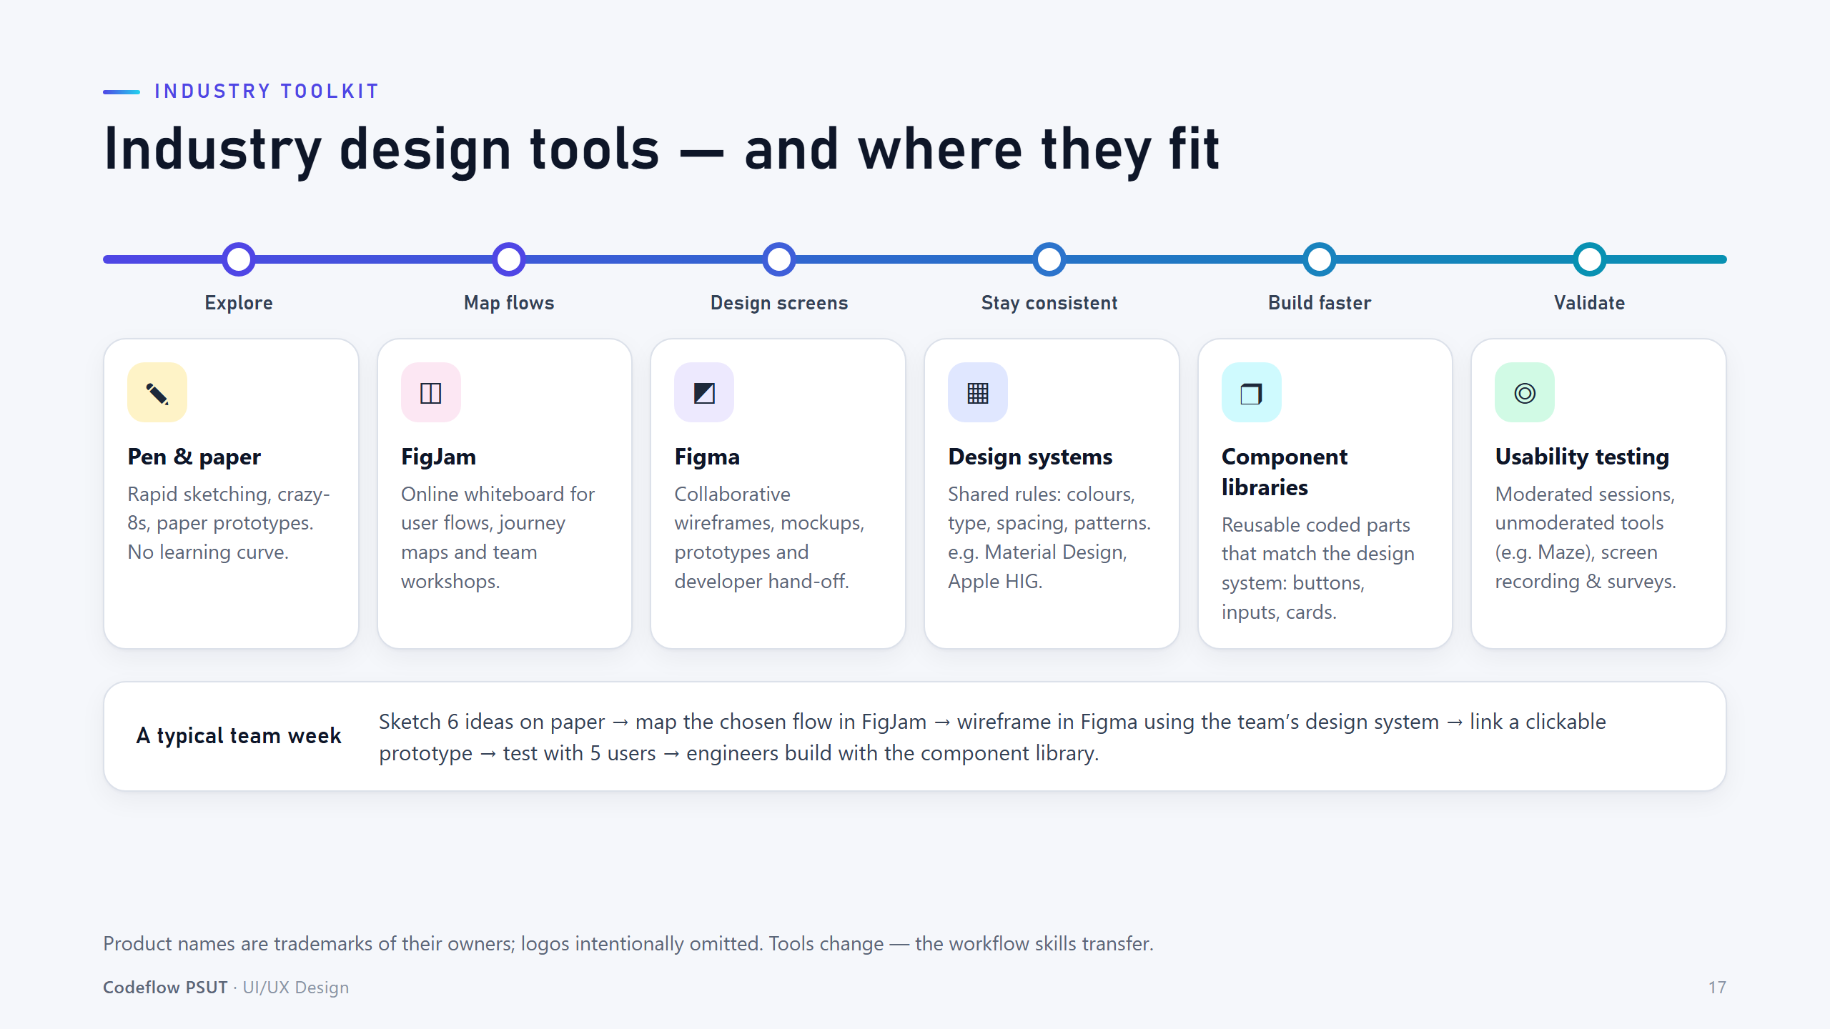
Notes:
Tools change; the workflow transfers. Explore on paper, map flows in FigJam, design in Figma, test with users.

Slide 18
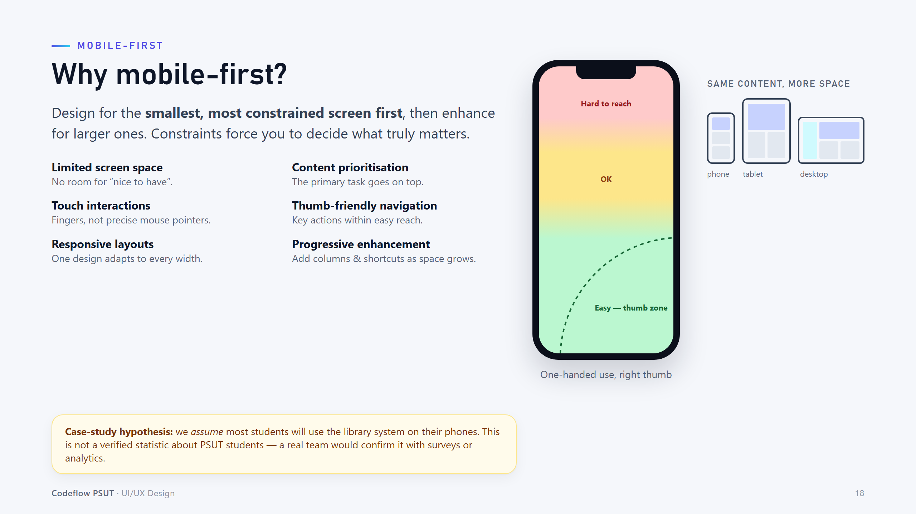
Notes:
Mobile-first forces prioritisation. Emphasise that 'most students use phones' is a hypothesis we would validate, not a fact.

Slide 19
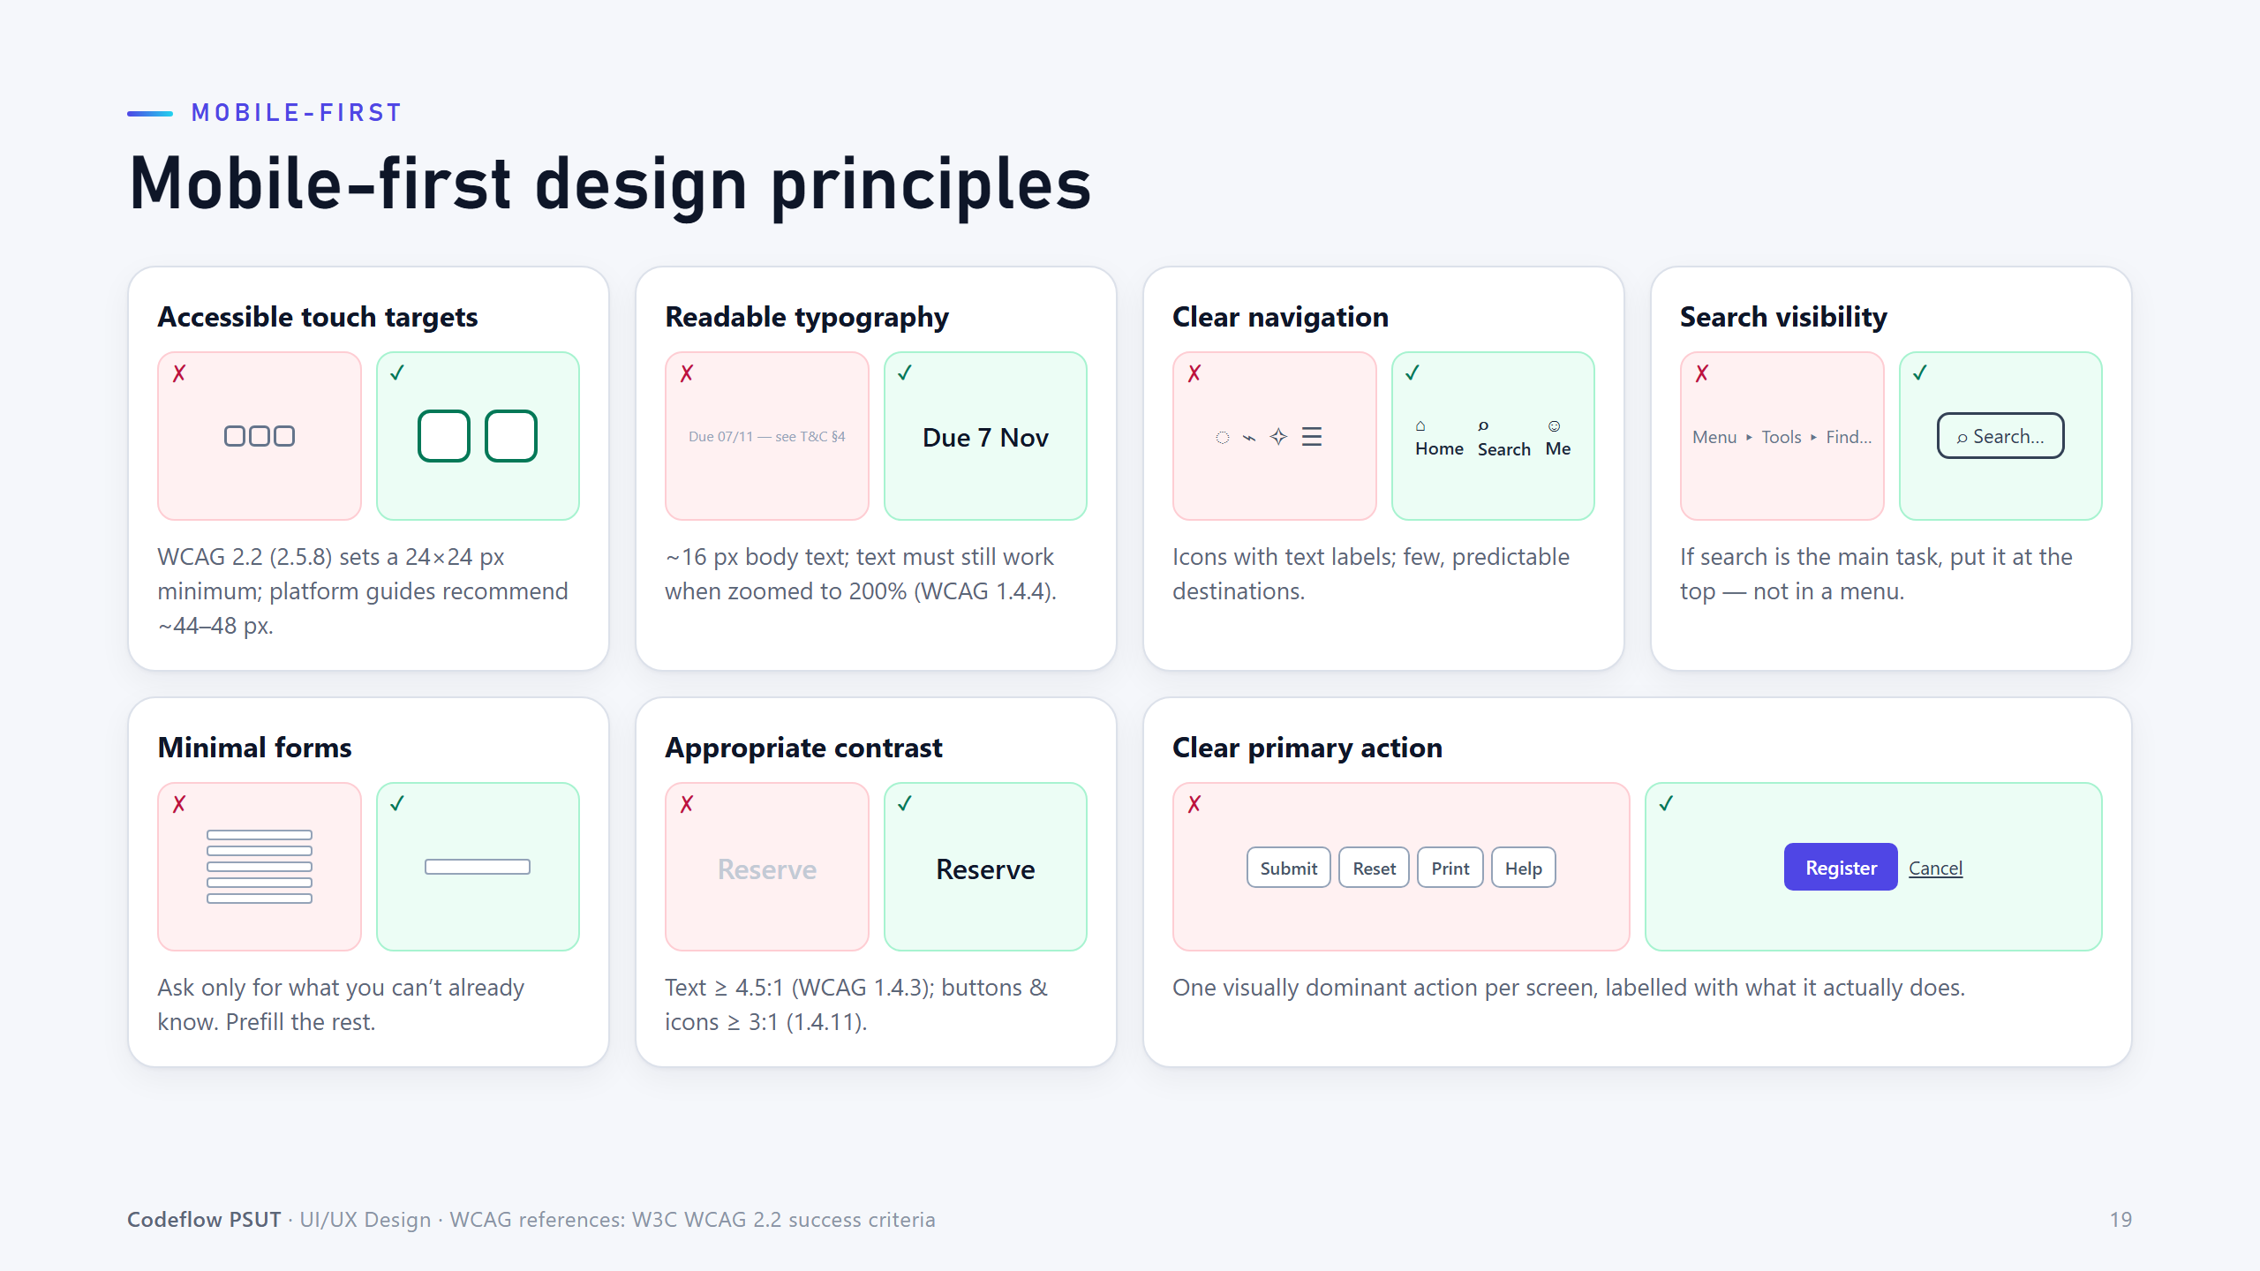
Notes:
Concrete do/don't pairs. WCAG 2.2 target-size minimum is 24x24 CSS px; platform guides recommend about 44-48.

Slide 20
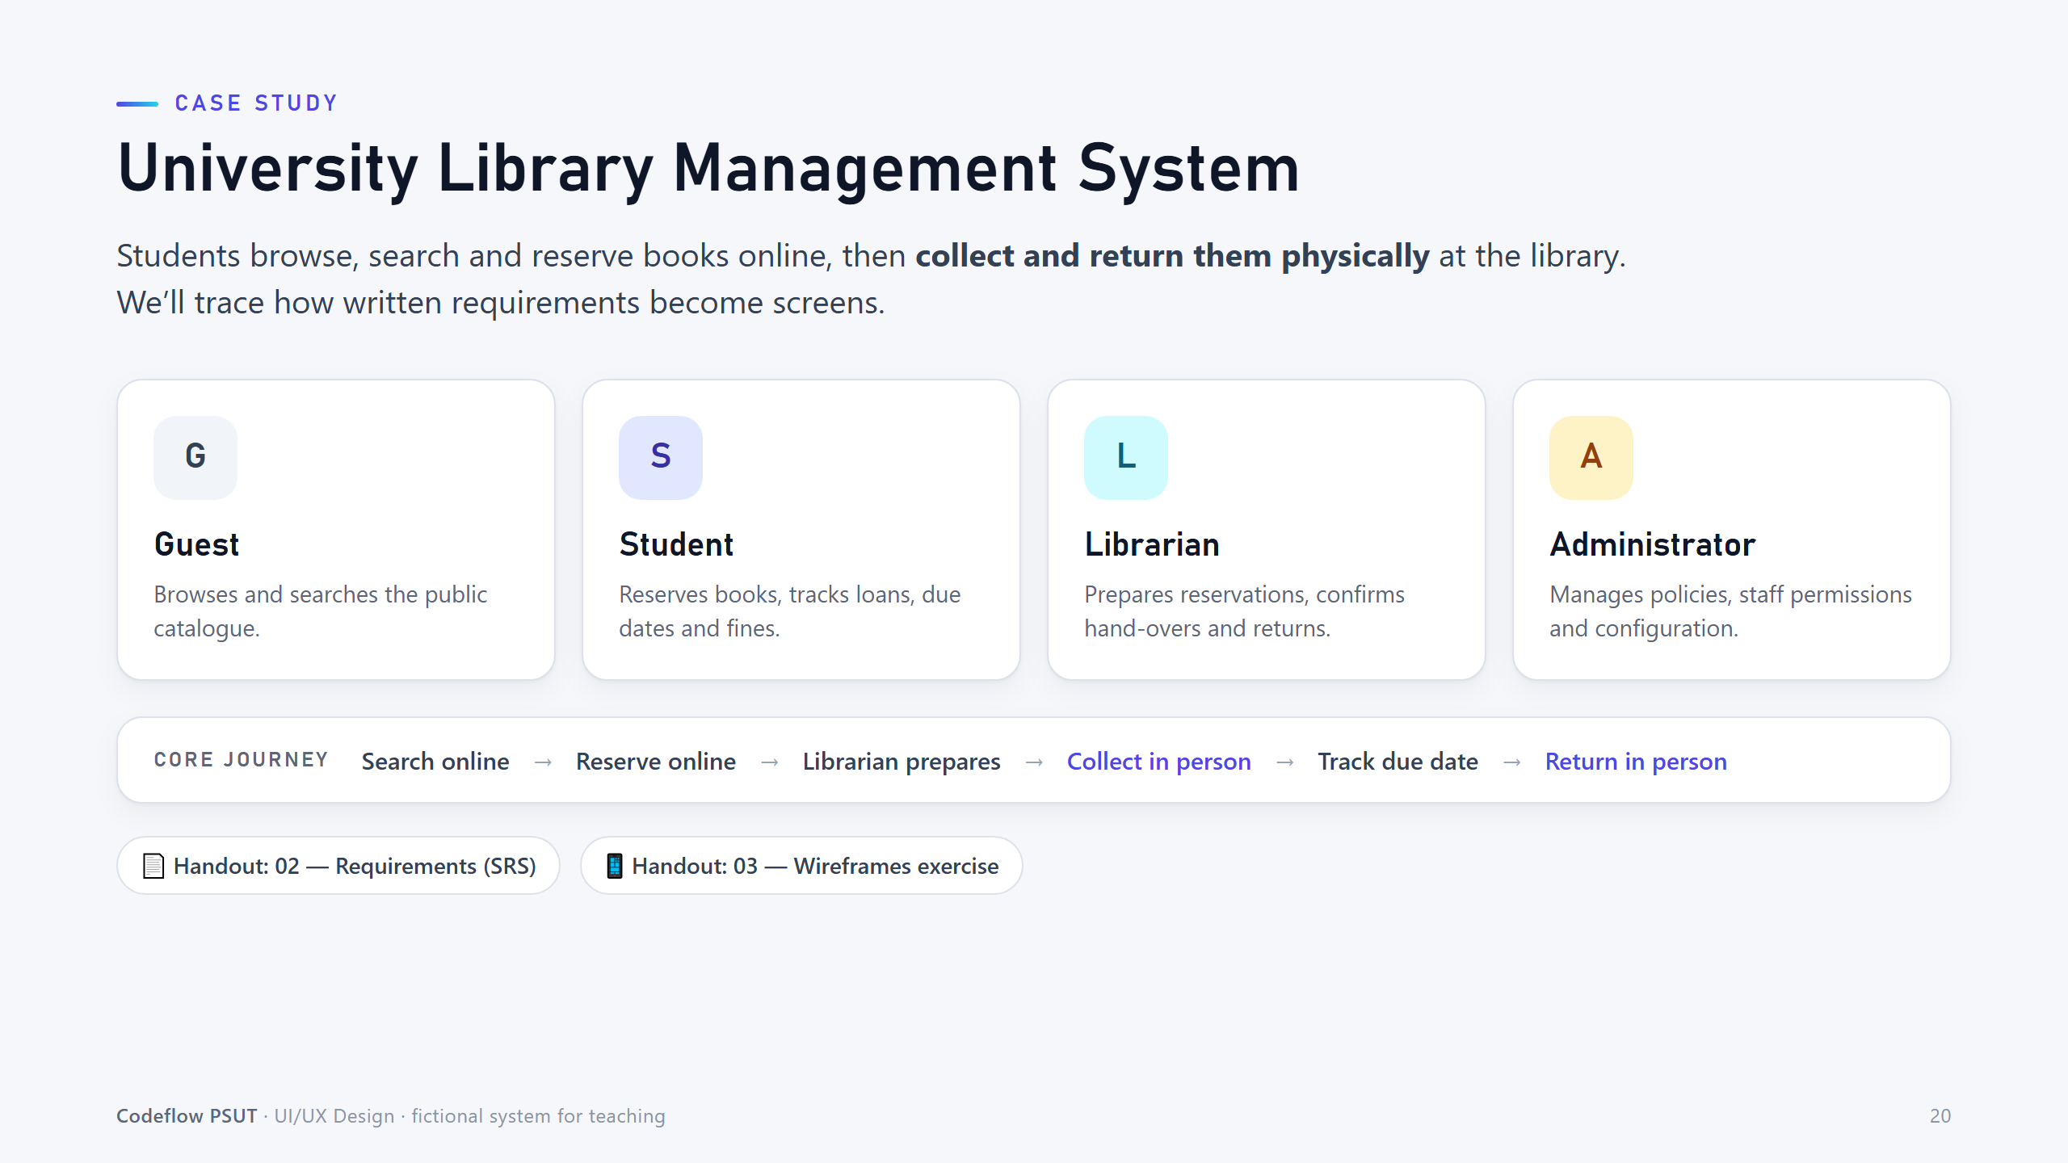
Notes:
Introduce the case study and the four roles. Hand out 02 (SRS) and 03 Parts A-B only.

Slide 21
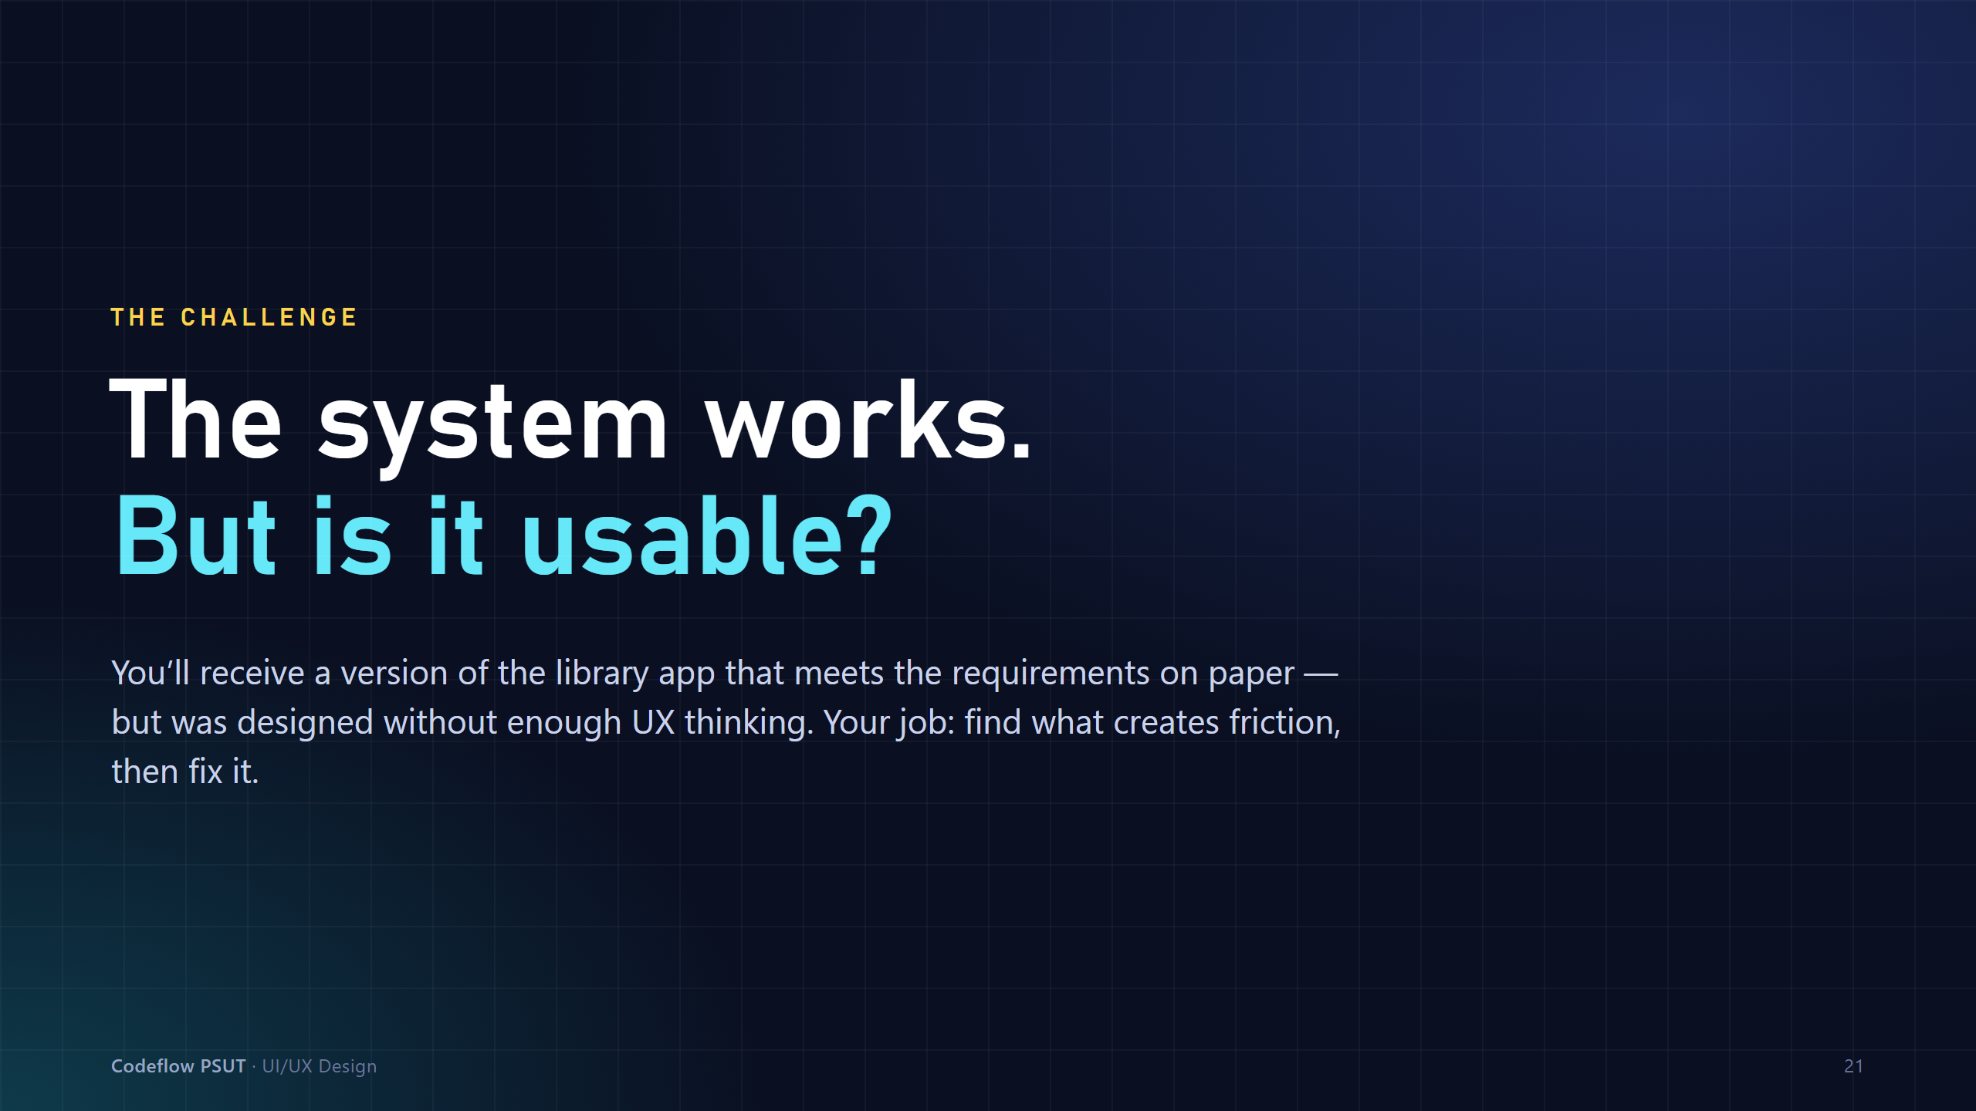
Notes:
Build suspense: the system meets the requirements on paper. Do not reveal any of the problems.

Slide 22
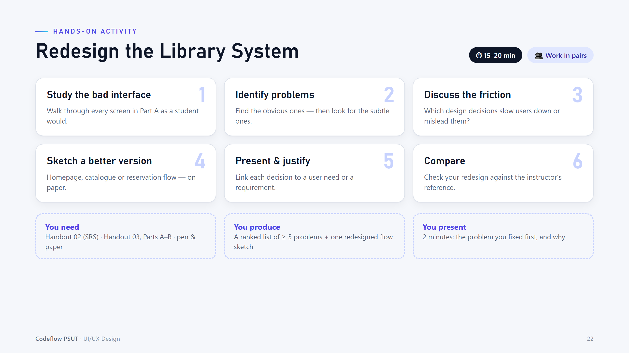
Notes:
Pairs, 15-20 minutes. Circulate and push pairs to justify each problem with a user need or requirement.

Slide 23
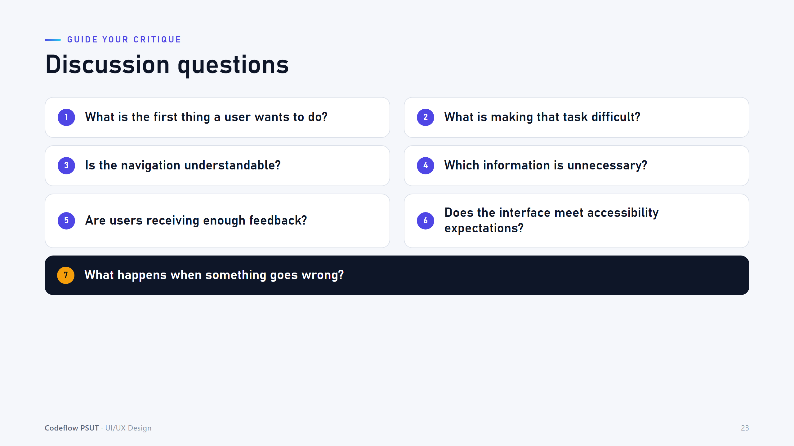
Notes:
Use these questions to unblock pairs who are stuck. Then run the reveal from handout 03, Part C onward.

Slide 24
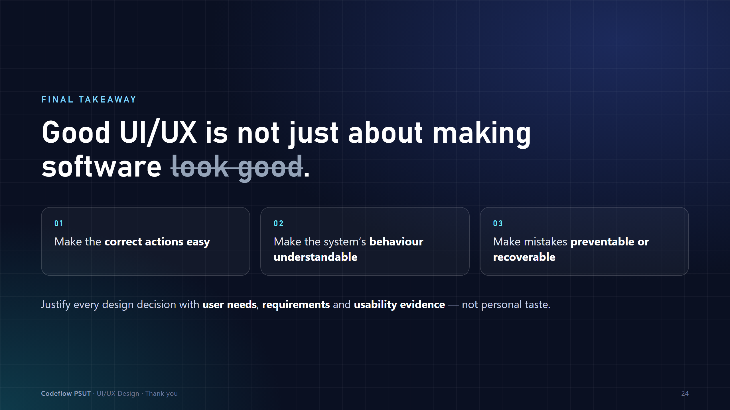
Notes:
Close: design decisions must be justified by user needs, requirements and usability evidence - not taste.

